Slide 1



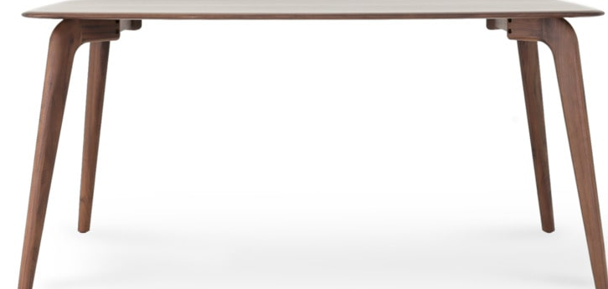
You are trapped in this room try to escape!

Slide 2



1
2
3
4
Hint:
Sorry no hints ☹
Please enter password to unlock PC
Back

Slide 3
1
2
3
4
Hint:
Sorry no hints ☹
Please enter password to unlock PC

Slide 4
1
2
3
4
Hint:
Sorry no hints ☹
Please enter password to unlock PC

Slide 5
1
2
3
4
Hint:
Sorry no hints ☹
Please enter password to unlock PC

Slide 6
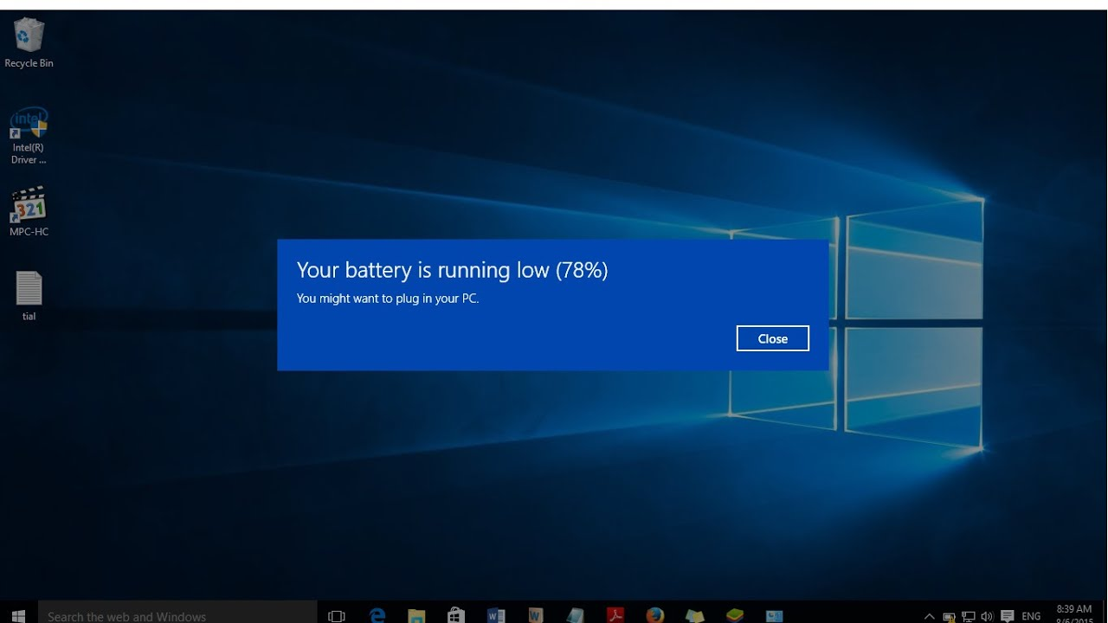

Slide 7


Notepad-Untitled 4

Slide 8
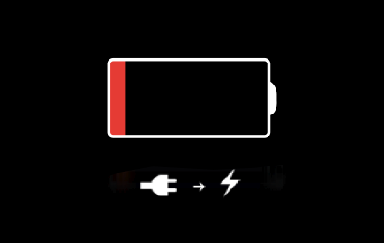
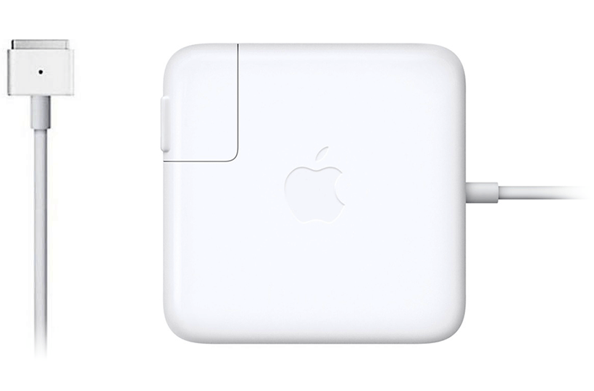
Low battery Charging 1% wait 1-minute until 100%
Charging 1%

Slide 9
100 % battery Charged

Slide 10
Notepad-Untitled 4

Slide 11
Back

Slide 12
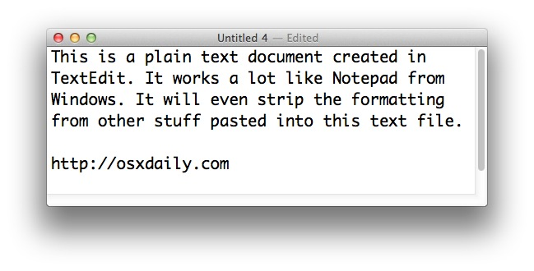

Exit door Password : 111
Return to Exit door

Slide 13
Low battery Charging 1% wait 1-minute until 100%
Charging 1%

Slide 14
100 % battery Charged

Slide 15
The password is for the PC is: 4231
Return to PC

Slide 16
1
2
3
4
Enter password for door

Slide 17
1
2
3
4
Enter password for door

Slide 18
1
2
3
4
Enter password for door

Slide 19
Wrong password try again
Return to beginning

